Slide 1
Project presentation Tip amount prediction
Big Data Labs
Alexander Janzen & Matthias Kühnel

Slide 2
Project idea
Maximizing the taxi driver‘s profit by analyzing the taxi data given from the official NYC taxi website
Goal:
show average values for each area (Staten Island, Manhattan, ...), for example tip_amount/mile, average tip amount, number of taxi trips in a certain amount of time on a map of NYC
Show more information for the taxi drivers in which area they can make more money
Used data for this approach:
Start position of the taxis
Type of payments with credit card ( tip amount is listed only there)
Average money earned per mile via calculation

Slide 3


Implemenation Idea & achievements
Level 1
Import of taxi data via Scoop
Create database via HDFS
Level 2
Create a Producer via Kafka for streaming
Create a consumer via Kafka for processing data
Use Pyspark to prepare the data for the producer
Level 3
- Visualization of static/dynamic data on a NYC map via PIL (Imaging Library)

Slide 4
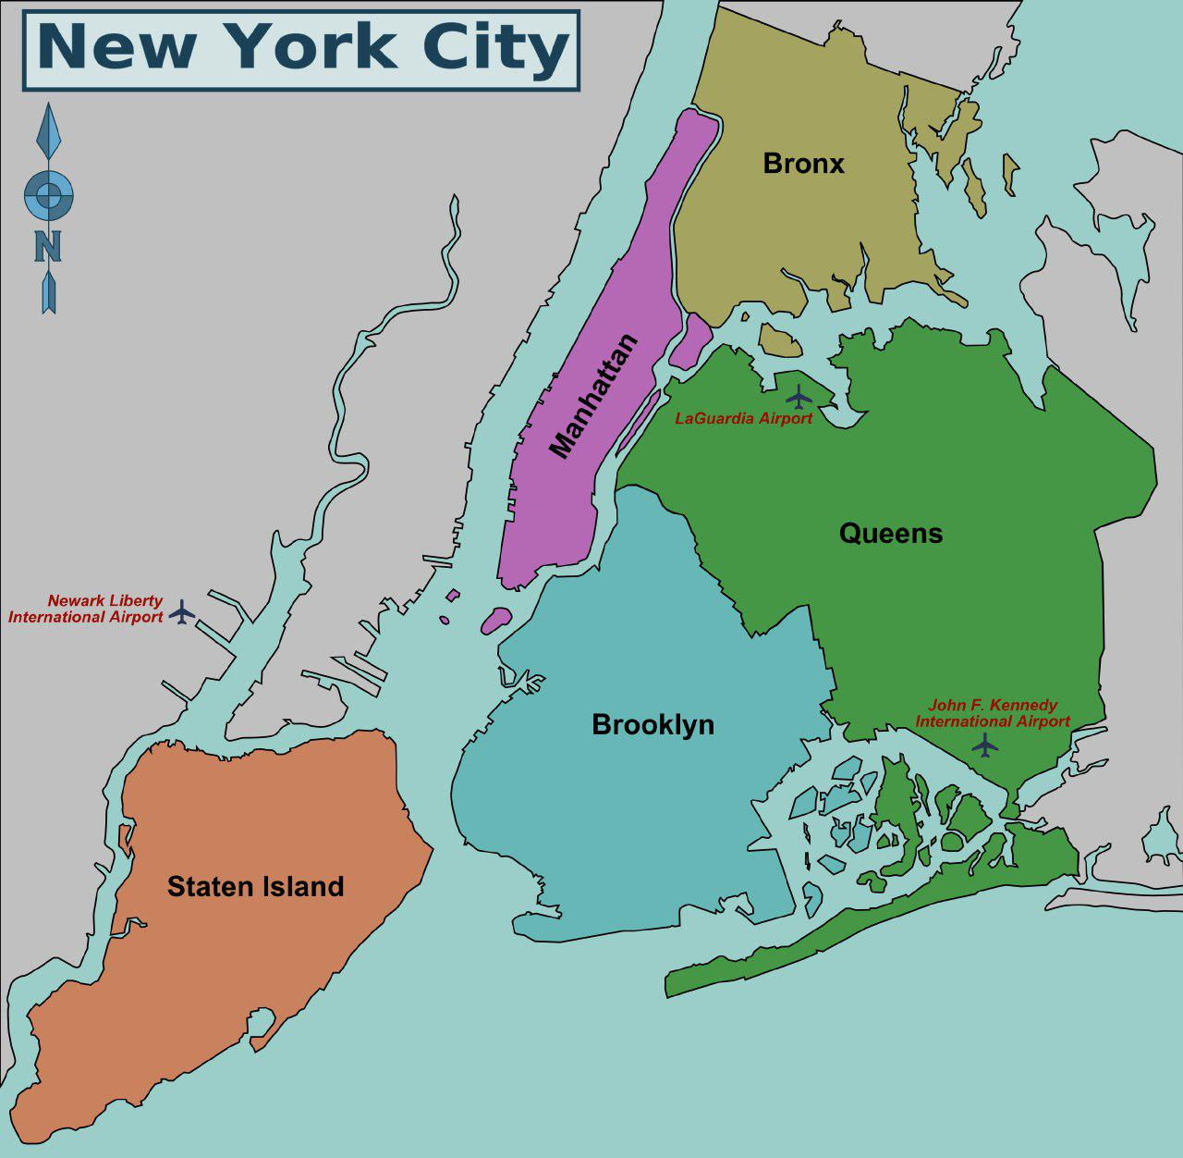





Visualization
TAXI DATA
as CSV file(s)
Model via HDFS

Slide 5
Static model achievements

Slide 6
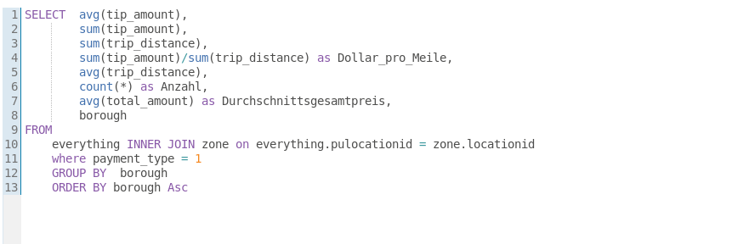
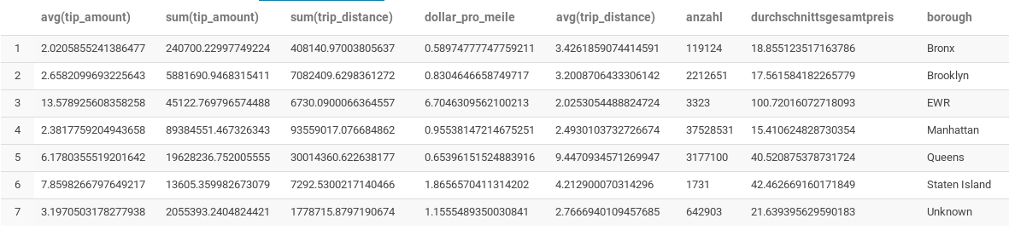
Static model achievements
→ Displaying the values onto the map worked as expected

Slide 7
Static model achievements
Other results
Most profitable area based on static information can be suggested (Newark Airport)
But: only 3000 entries are counted here
The least profitable area based on tip_amount/mile & average tip_amount (Bronx)
Most entries are counted for Manhattan (about 36 million entries)
The least entries are counted for Staten Island (about 1200 entries)

Slide 8

Fails
Spark itself had a lot of issues regarding the local ip
When setting the local ip explicit, jupyter wasn‘t working properly on the other side and the kernel crashed.
No solution worked for us so far
→ Because of this, testing the stream (which worked itself) with our data wasn‘t working as expected.

Slide 9
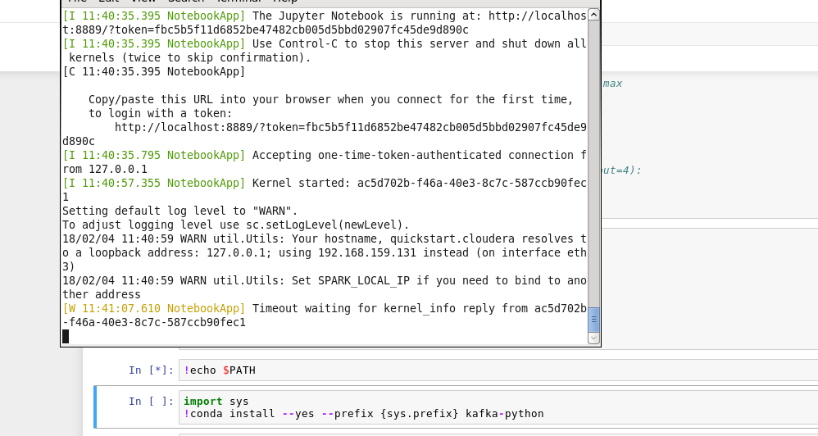
Fails

Slide 10
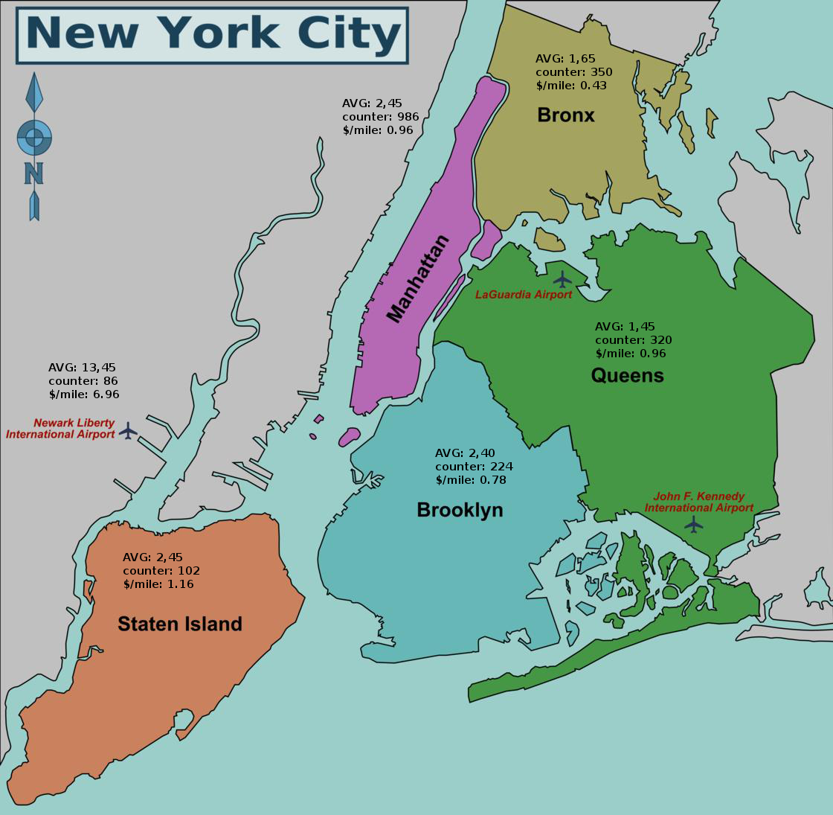
Stream processing of taxi data and displaying via Python Library

Slide 11
THANK YOU FOR YOUR ATTENTION!

